Slide 1


Shield
Insurance
Business & Sales Analysis Dashboard
A.Abhilash Reddy

Slide 2

SHIELD INSURANCE
ABOUT
FAUGET
LOCATIONS
PRODUCTS
SALES MODE
AGE GROUP
POL4321HEL
Mumbai
Online App
18-24
POL4331HEL
Hyderabad
25-30
POL3309HEL
Online Web
POL5319HEL
31-40
New Delhi
Offline Direct
41-50
POL2005HEL
Chennai
POL1048HEL
Offline Agents
51-65
Indore
POL9221HEL
65+
POL6093HEL
POL6303HEL
A.Abhilash Reddy

Slide 3
SHIELD INSURANCE
Objective
The analysis focuses on:
Total customers and over all revenue Analysis.
Daily revenue growth and daily customer growth rate.
Month-over-month comparison of revenue and customer growth.
Monthly trends in revenue and customer acquisition.
City-wise performance:
revenue and customer distribution across 5 cities
Age group analysis:
customer behavior and contribution by age segments
Product preference trends across different age groups
Sales mode performance
offline agents, direct, online app, and web
Comparison of revenue vs customer acquisition across sales channels
Overall revenue and customer split (%) by sales mode
A.Abhilash Reddy

Slide 4
SHIELD INSURANCE
Key Metrics
Total Customers
26841
Daily customer growth
148.29
total Revenue
₹989.3 M
Daily revenue growth
5.47 M
March recorded the highest revenue of ₹263.84 Million, contributing 26.6% to the overall revenue.
The ₹5000 premium policy emerged as the most sold premium policy across the dataset.
Delhi led in both revenue generation and customer acquisition, closely followed by Mumbai.
The 31–40 age group contributed the highest number of customers and revenue contribution making it the most engaged segment.
A.Abhilash Reddy

Slide 5
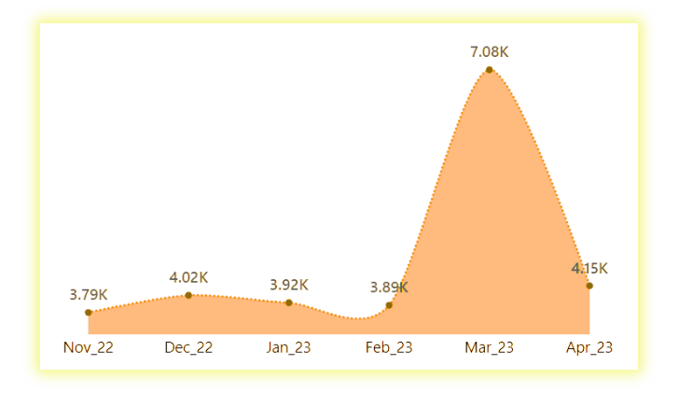
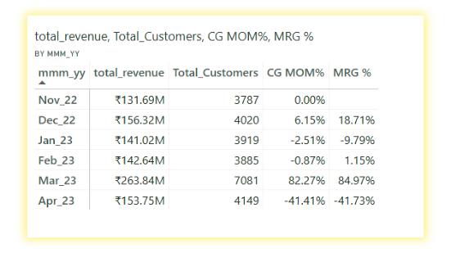
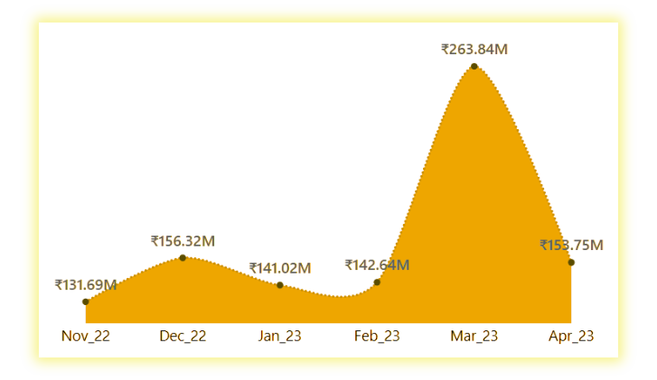
Trend Chart Analysis
Mom
customer trend
Key points
March marked the peak for both revenue and customer count across all months.
February to March saw the highest growth: Revenue up by 84.97%, Customer base up by 82.27%.
November recorded the lowest performance in both metrics.
Between November and December, revenue increased by 18.7% despite only 6.15% customer growth, indicating higher value per customer.
A minor decline occurred from January to February, showing a temporary slowdown.
From March to April, there was a significant drop of 41.7% in revenue, with a corresponding decrease in customer count.
Revenue trend
A.Abhilash Reddy

Slide 6
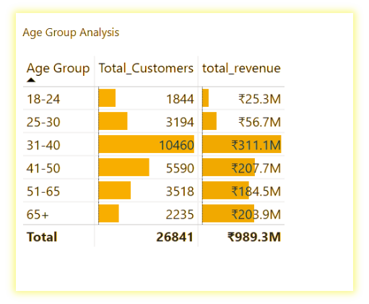
age group
Analysis
The 31–40 age group dominates with 10,460 customers and generates the highest revenue of ₹311.1M, contributing nearly 31% of total revenue.
The 41–50 group follows with 5,590 customers and ₹207.7M, showing strong engagement and purchasing power.
Though the 65+ segment has only 2,235 customers, it contributes ₹203.9M, indicating high revenue per customer.
The 18–24 group is the smallest both in customers (1,844) and revenue (₹25.3M), reflecting limited purchasing capacity..
Age groups 31–65 form the core base, accounting for over 80% of total revenue, making them the primary target for premium policies.
A.Abhilash Reddy

Slide 7
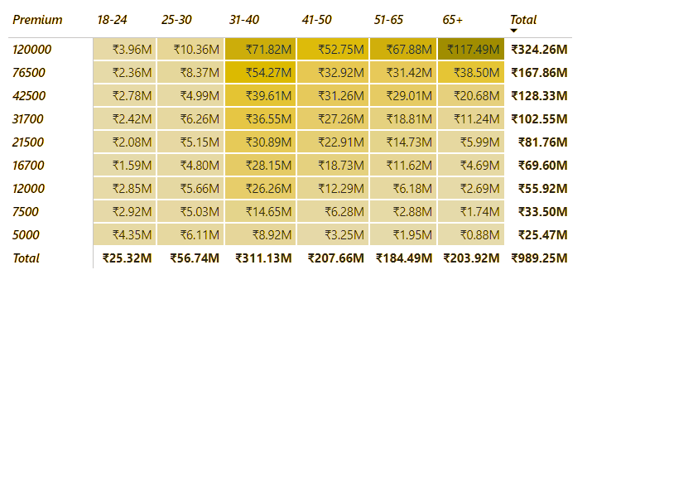
Premium & Age group Analysis
The ₹5000 premium has the highest number of customers (4,434) but generates only ₹25.47M, indicating low revenue per customer.
₹120000 premium leads in total revenue (₹324.26M) despite fewer customers, showing high-value conversions, especially from 31–65+ age groups.
The 31–40 age group is the largest segment with 10,460 customers and contributes the most revenue: ₹311.13M, making it the core target audience.
₹76500 is the second-highest revenue generator (₹167.86M), mainly driven by the 31–50 and 65+ age groups.
Lower-value premiums like ₹5000 and ₹7500 attract more young customers but yield less revenue, suggesting they are entry-level plans.
High-premium plans (₹42500 and above) are preferred by age groups (31–65+)
A.Abhilash Reddy

Slide 8
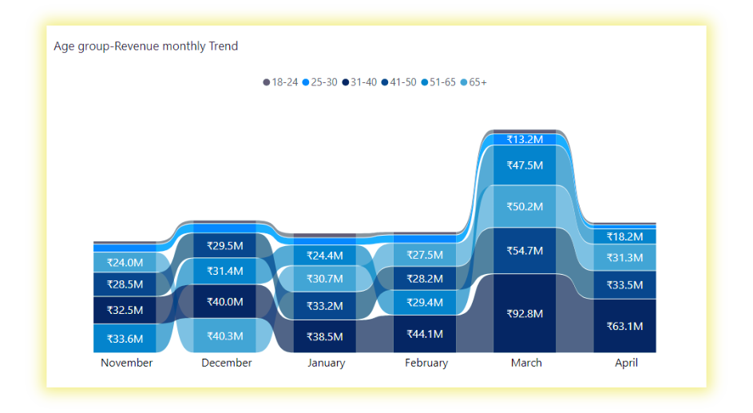
Age group trend Analysis
six-month trend analysis of revenue contributions by age group.
The main competition here is between 31–40, 41–50, 51–65, and 65+.
The 18–24 and 25–30 groups consistently contribute the least.
Interestingly, the 51–65 age group started off strong in November but declined gradually to the fourth position.
The 65+ group shows steady growth, climbing from fourth place to third, now contributing nearly 20% monthly.
The 41–50 group remains stable, contributing around 20% each month with minor fluctuations.
The standout performer is the 31–40 segment, which grew steadily to dominate revenue share, peaking at 41% in April.
A.Abhilash Reddy

Slide 9
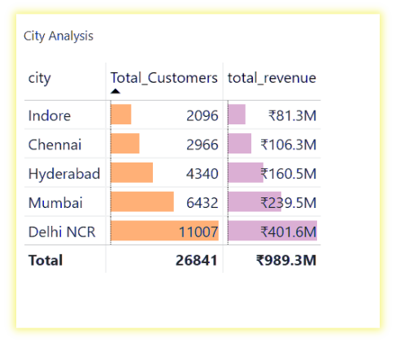
City
Analysis
Delhi NCR leads in both metrics with 11007 customers and ₹401.6M in revenue, contributing over 40% of total revenue.
Mumbai ranks second, with 6432 customers and generating ₹239.5 M, over 24% of total revenue.
Hyderabad follows with 622 customers and ₹23.1M, showing balanced performance.
Chennai and Indore recorded the lowest figures, with 2966 and 2096 customers and revenue 106.3 M and ₹81.3 M respectively,
Delhi and Mumbai together account for more than two-thirds of overall revenue, making them key strategic markets.
A.Abhilash Reddy

Slide 10
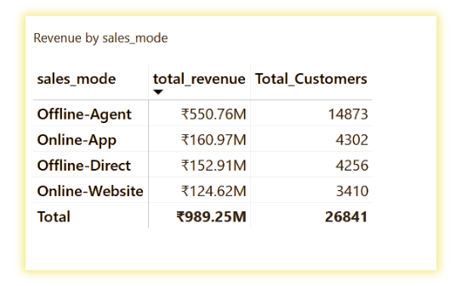
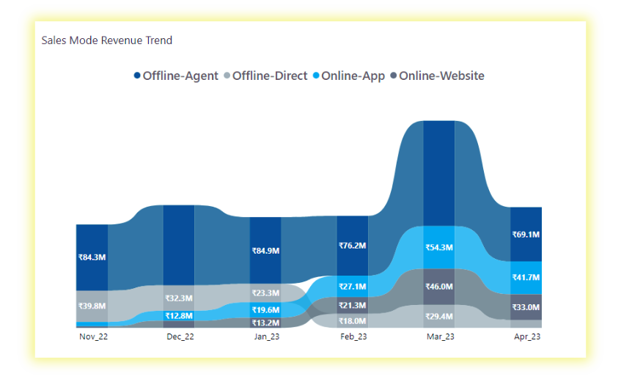
Sales mode Analysis
Offline-Agent is the top sales mode with the most customers (14,873) and the highest revenue (₹550.76M).
Online-App and Offline-Direct have similar customer numbers (around 4,300) and good revenue (₹160.97M and ₹152.91M).
Online-Website has the fewest customers (3,410) and the lowest revenue (₹124.62M).
Offline agents currently drive 55.6% of total revenue, and customer acquisition is strongest through them.
However, interesting shifts are seen month-on-month
Online App grew from 4% to 27.1%, now ranking 2nd.
Offline Direct dropped from 30.2% to 6.5%, slipping from 2nd to 4th place.
Online Web moved up from the bottom to 3rd position.
This shows customers are adopting online channels.
SALES MODE TREND
A.Abhilash Reddy

Slide 11
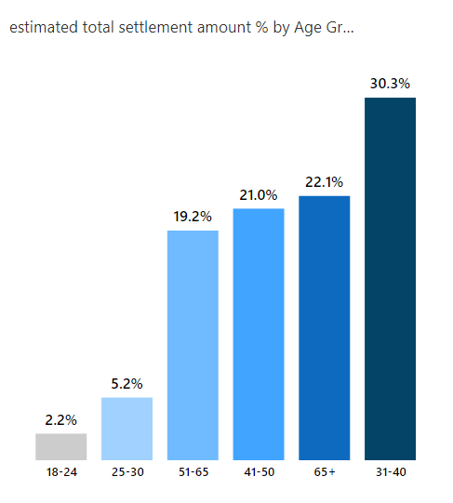
expected settlement
The 31–40 age group has the highest total claim settlement – ₹480.1M.
The 65+ age group also has high settlement value, even with fewer customers.
Middle age groups (41–65) show steady claim settlements, making them important for the business.
Younger groups (18–30) have lower settlement amounts, likely because of smaller policies or fewer claims.
This shows that older and middle-aged customers use their policies more or have higher policy values.
A.Abhilash Reddy

Slide 12
Recommendations
Run focused campaigns in Indore and Chennai to improve customer base and revenue contribution from underperforming cities.
Continue market dominance in Delhi and Mumbai with retention and upsell strategies.
Launch targeted campaigns for the 18–30 age group to boost engagement and drive early adoption.
Refocus on the 51–65 age group, where revenue is steadily declining, to reignite interest with tailored plans.
Leverage the growing adoption of online channels by enhancing digital presence through app and website promotions.
Promote higher premium plans like ₹76500 and ₹120000 to increase overall revenue and attract high-value customers.

Slide 13
thank you for watching
A.Abhilash Reddy

